Slide 1
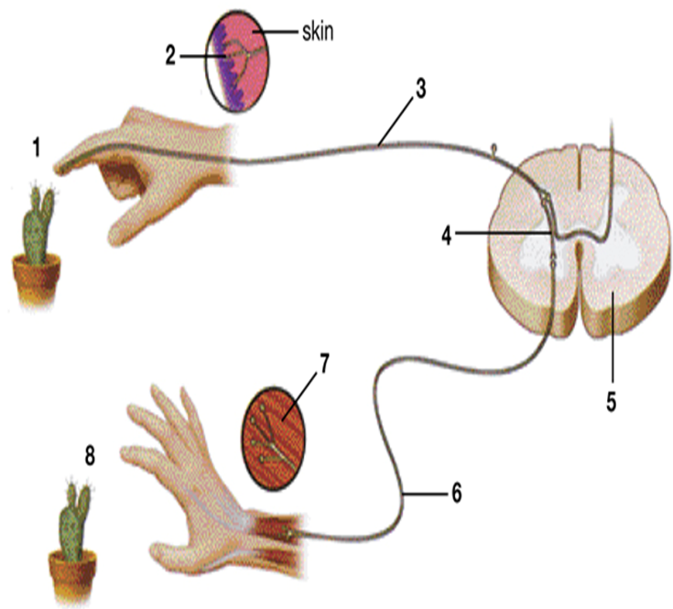
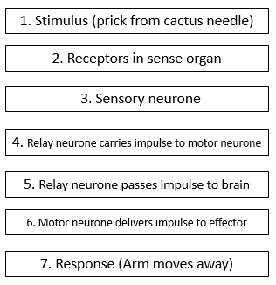
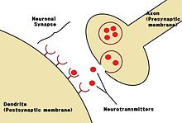
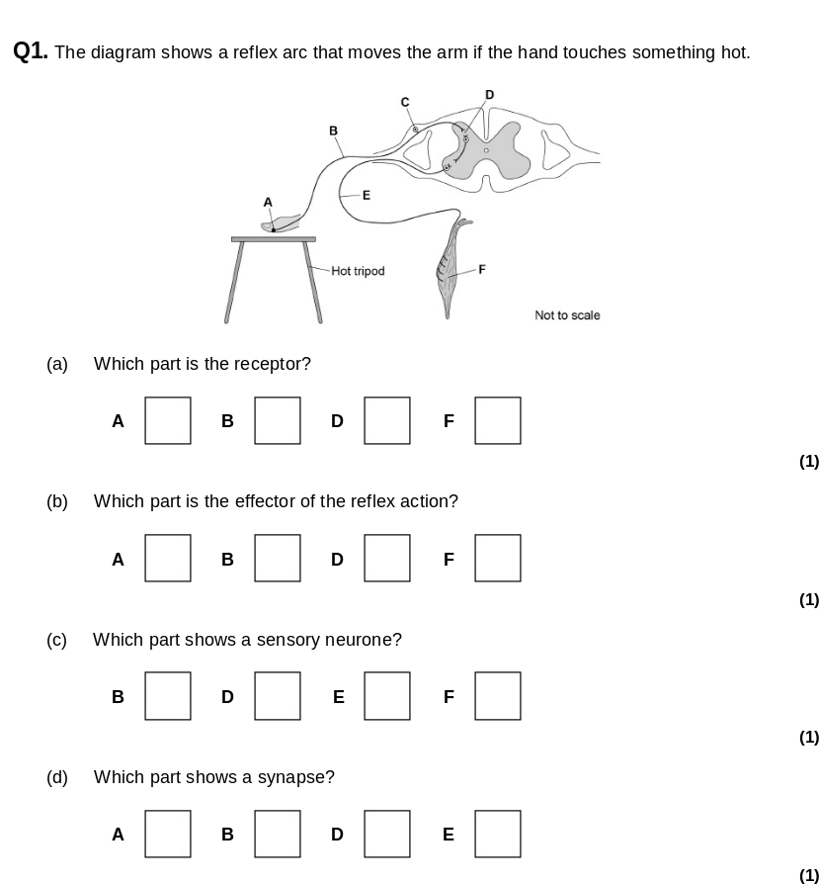
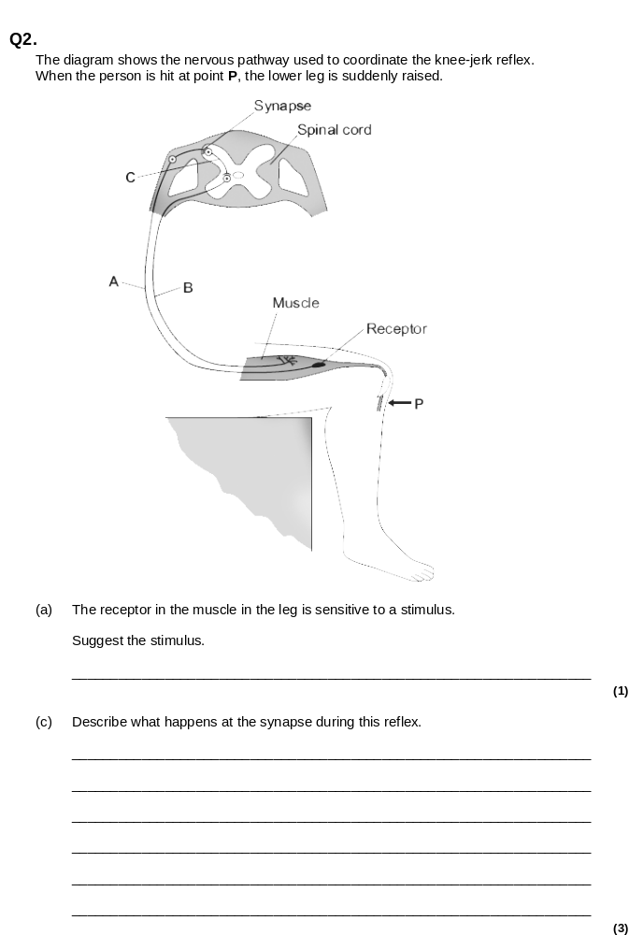
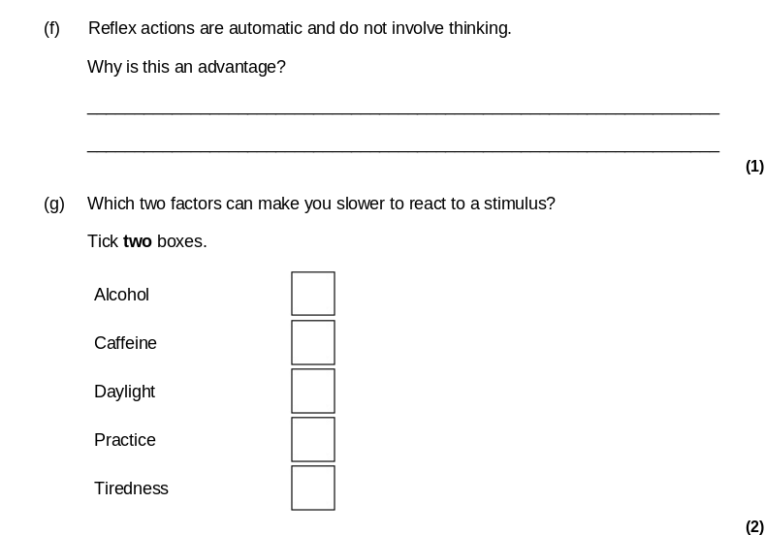
Homeostasis revision
Do Now: Define these terms
-effector
-receptor
-stimulus
-response
-neurone
-hormone
-synapse
-gland
The Nervous System
Receptor: senses change in environment e.g temperature, taste, sound
Coordinators: Brain, CNS, and glands around the body control the response
Effectors: Muscles will contract or relax and glands will release hormones
Reflexes are needed to protect the body.
Reflexes:
Are automatic and fast
do not involve the brain
only involve three neurones – sensory, relay and motor neurones
When an electrical impulse arrives at the end of a neurone a chemical is released. It diffuses across the synapse and attaches to next neurone causing an impulse.

Slide 2
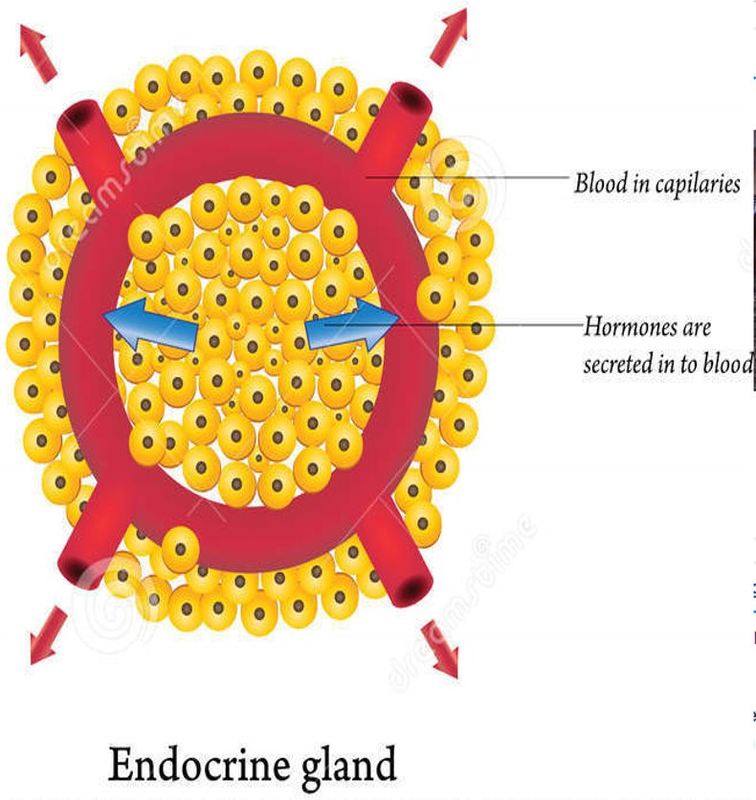
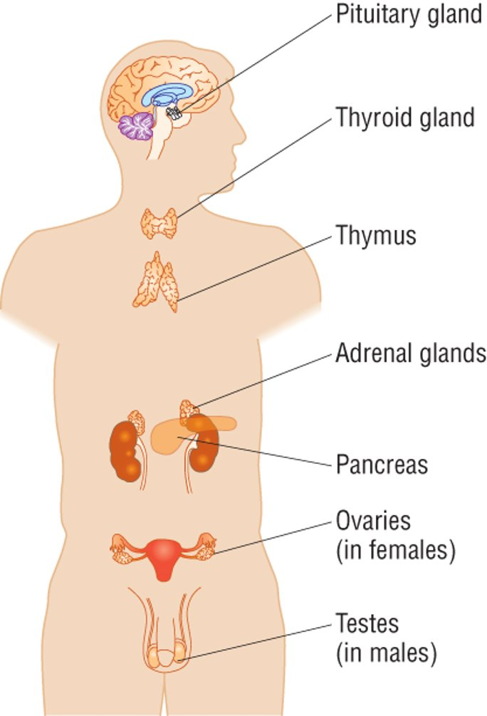
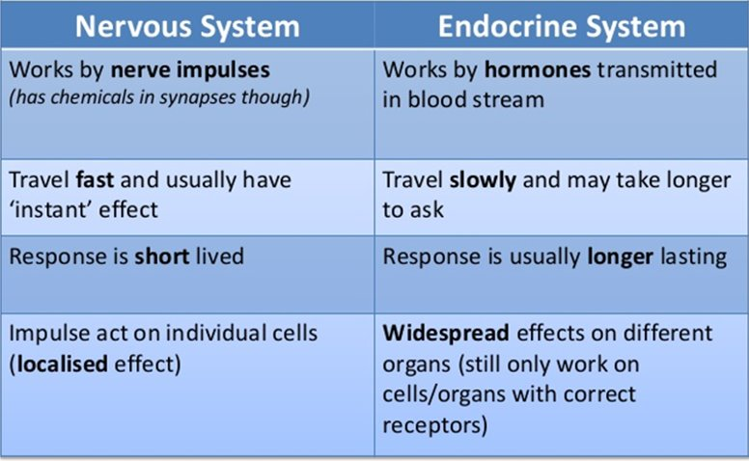
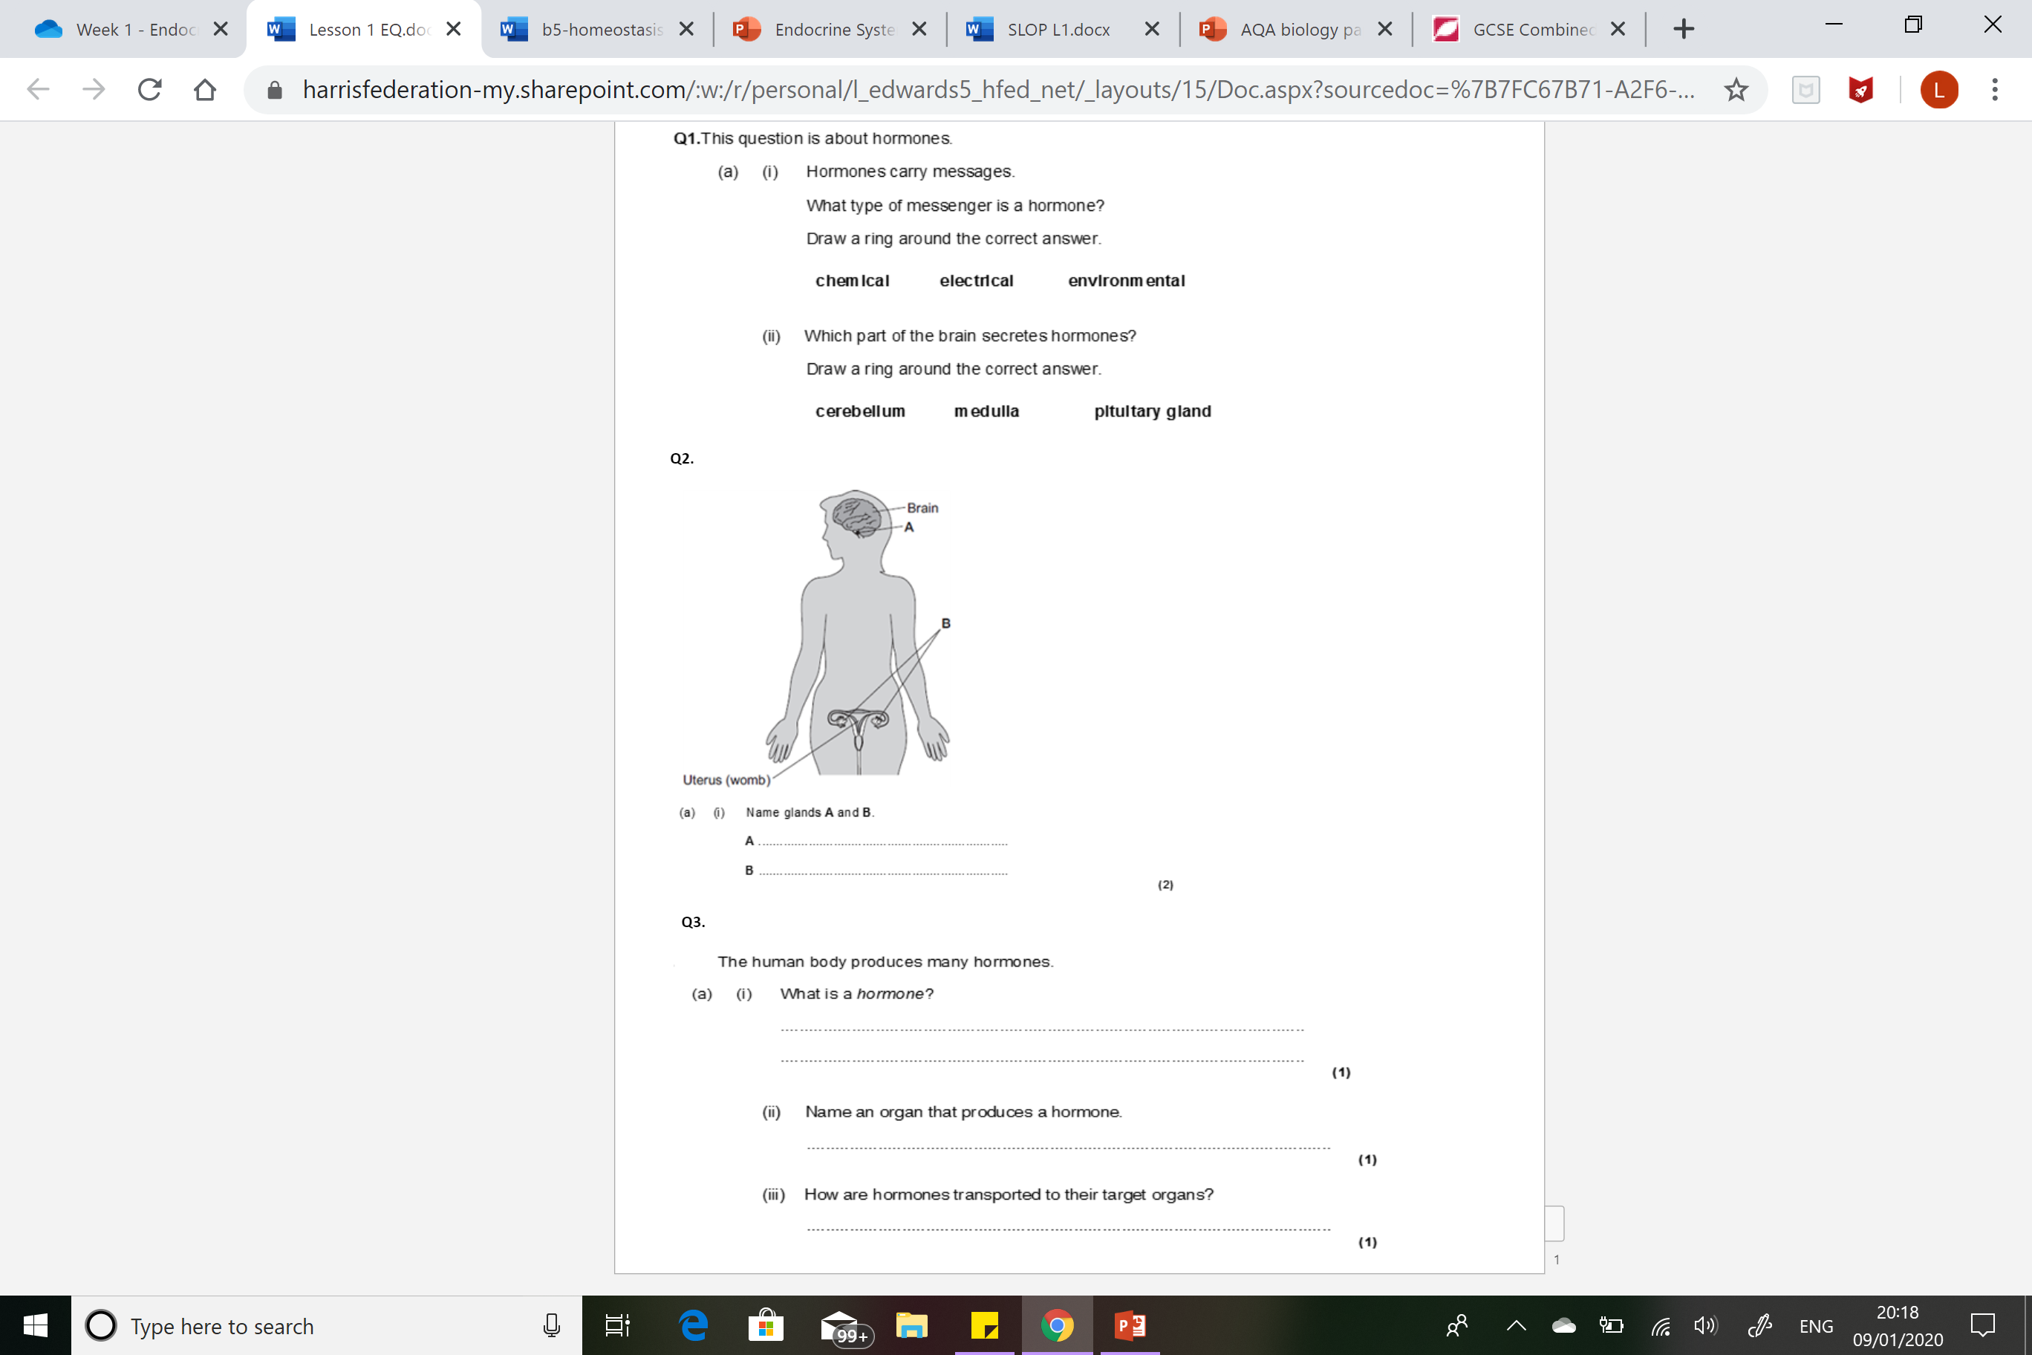
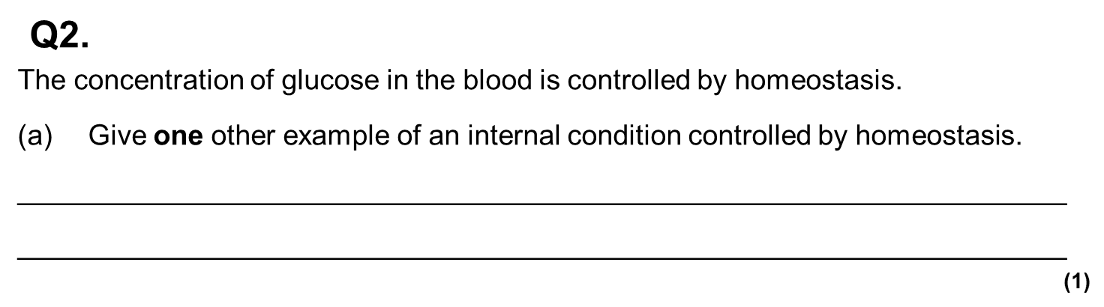
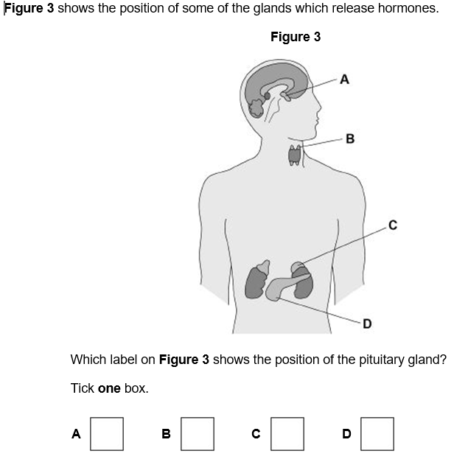
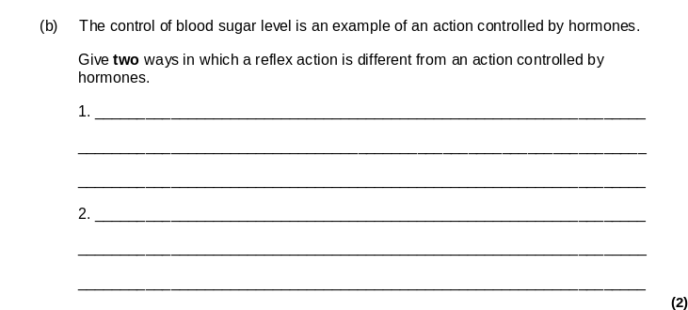
The Endocrine System and Hormonal Control
Humans, like all mammals need to maintain a constant internal environment. If our core body temperature, blood glucose levels, or water levels change too much we can get very ill or even die because changes in conditions can cause enzymes to denature. Enzymes are the main reason for homeostasis. Homeostasis is the regulation of the internal conditions of a cell or organism to maintain optimum conditions for function in response to internal and external changes.
Hormones are chemical messages secreted by the glands of the endocrine system​
​Hormones are released directly into the blood stream by endocrine glands. ​

Slide 3
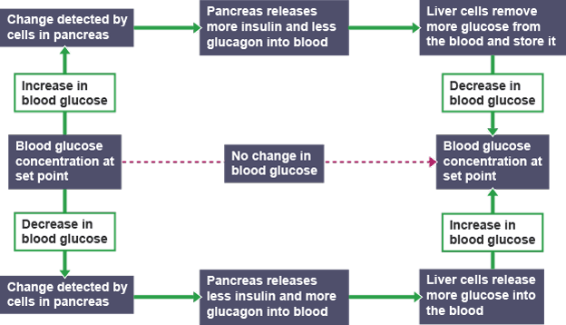
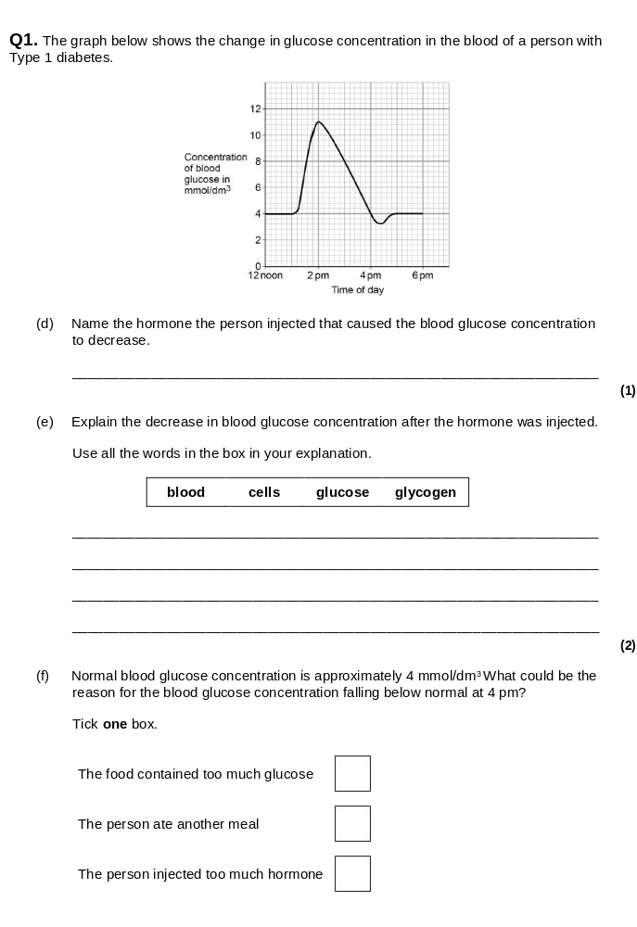
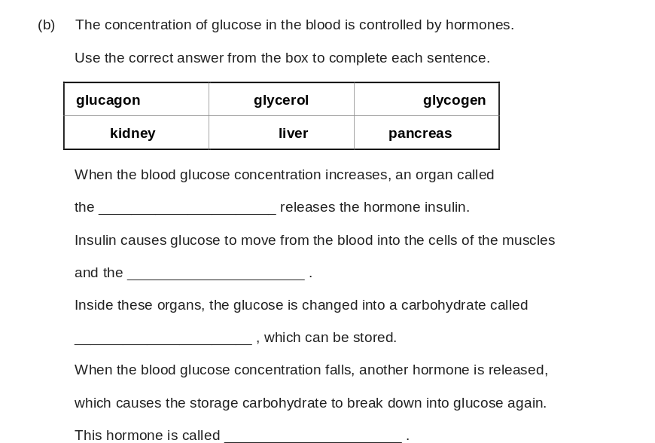
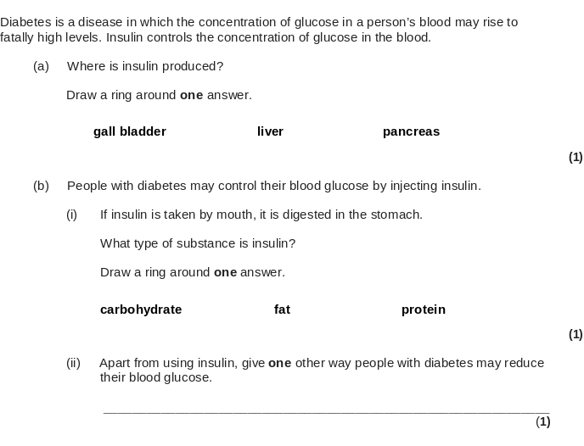
Regulation of Blood Glucose
Insulin – a hormone which decreases blood glucose by storing it as glycogen in the liver.
Glucagon – a hormone that increases blood glucose (by breaking down glycogen in the liver.
Glucose can be stored as glycogen in the liver.
Diabetes:
Type 1 – genetic disorder where pancreas does not produce insulin correctly. Treatment: Injecting insulin.
Type 2 – caused by fat around pancreas, obesity and poor diet. Treatment: diet and exercise.

Slide 4
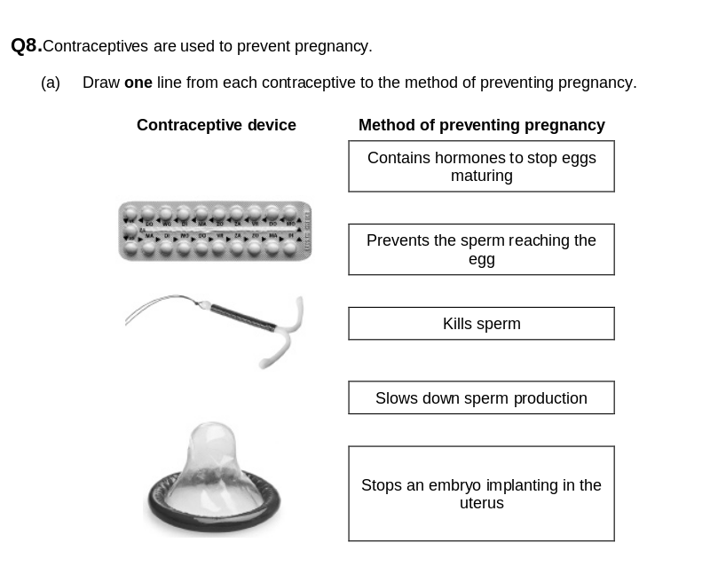
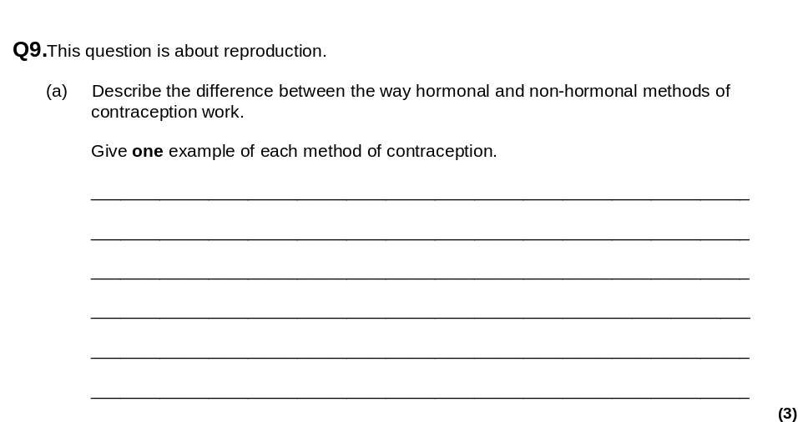
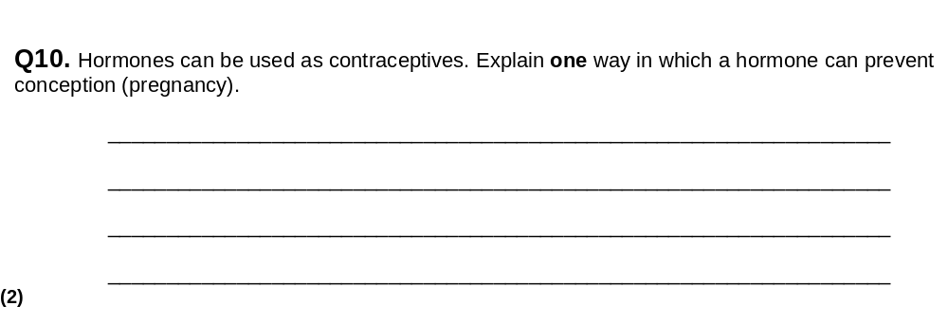
Contraception and Reproductive Hormones
Contraception: Any technology that prevents pregnancy.
Non-hormonal | Hormonal
Barrier methods – e.g condoms or diaphragm: Both of these provide a physical barrier that prevents sperm entering the uterus. | Oral contraceptive pill - Contains oestrogen and progesterone to inhibit FSH. Prevents an egg maturing.
IUD/Coil: prevent uterus lining building up
Spermicidal cream – kills sperm | Implant - Contains a slow release version of progesterone. Ensures that an egg is not released from the ovary.
Surgical Sterilisation – prevents person from releasing sperm or eggs permanently.
Male Hormones: Testosterone – produces sperm and develops secondary sexual characteristics
Female Hormones:
Follicle stimulating hormone (FSH): This causes an egg cell to mature in the ovaries
Luteinising hormone (LH): Stimulates the ovary to release the egg
Progesterone and Oestrogen: These maintain the uterus lining so a fertilised egg can be implanted and develop into an embryo.
(c) Progesterone is used in some contraceptives.
Suggest one advantage of using a progesterone patch rather than a progesterone oral contraceptive.
______________________________________________________________
____________________________________________________________(1)

Slide 5
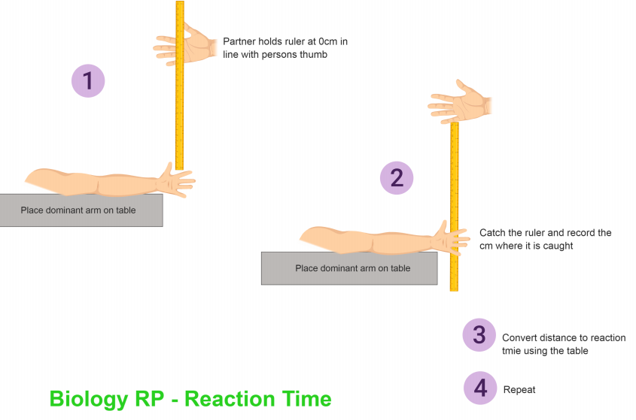
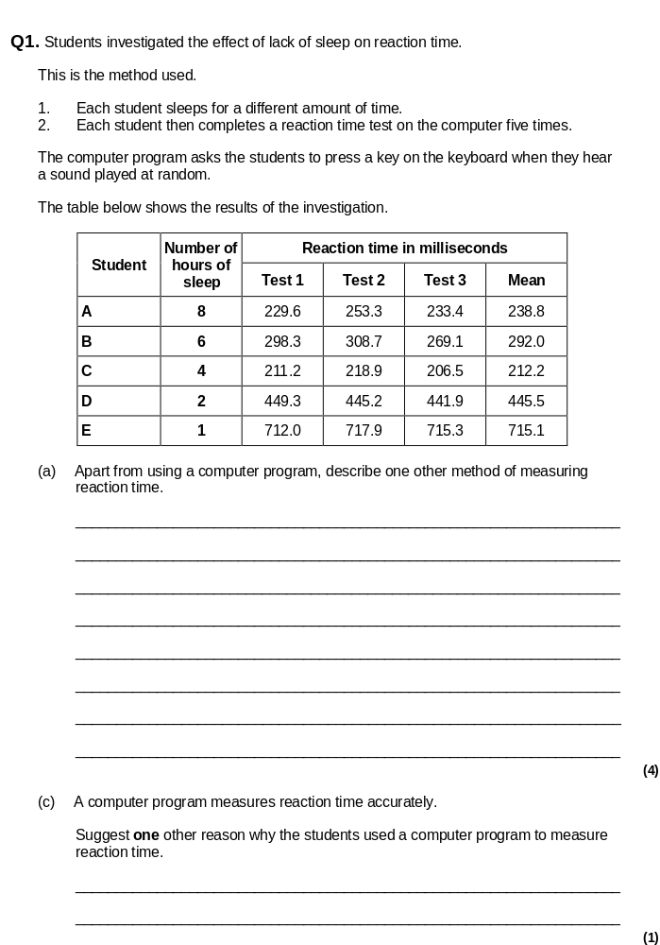
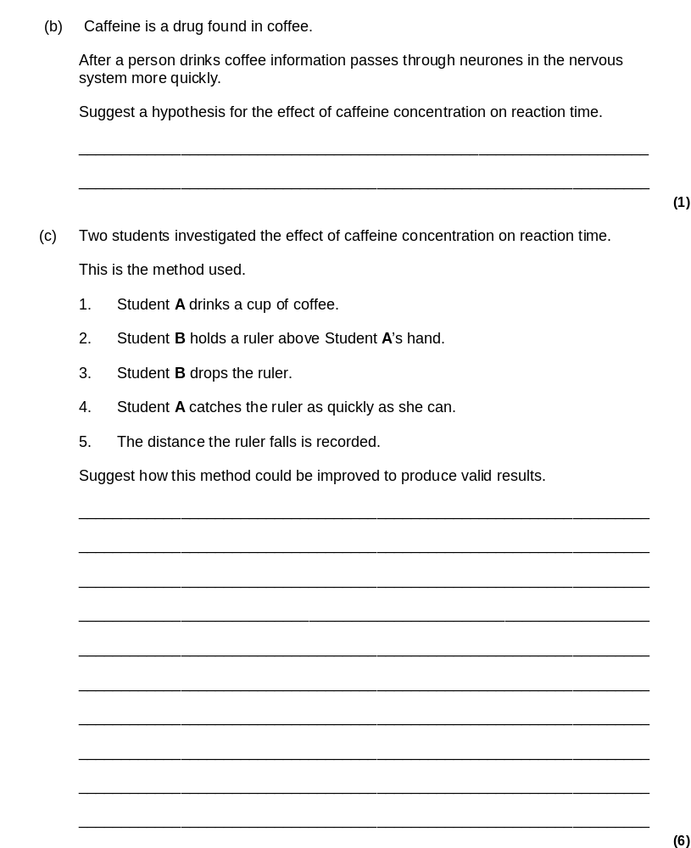
Required Practical – Reaction Times
Method:
Factors that can affect reaction time:
Practice​
Age​
Gender​
Stimulant/drug intake​
Tiredness​
Things to consider:
Does the method test what you want it to test?
Have you removed practice as a factor – e.g use left/non-dominant hand?
Ruler method or computer is more accurate than a stopwatch because then the subjects reaction time is measured not the person using the stopwatch.

Slide 6
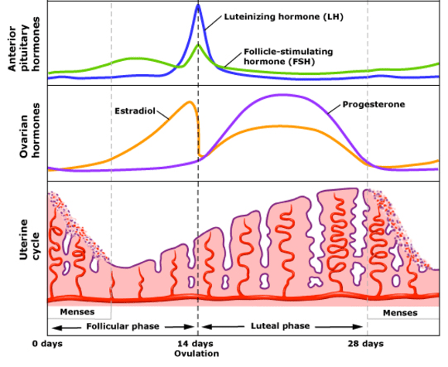
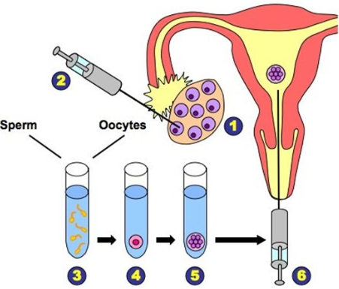
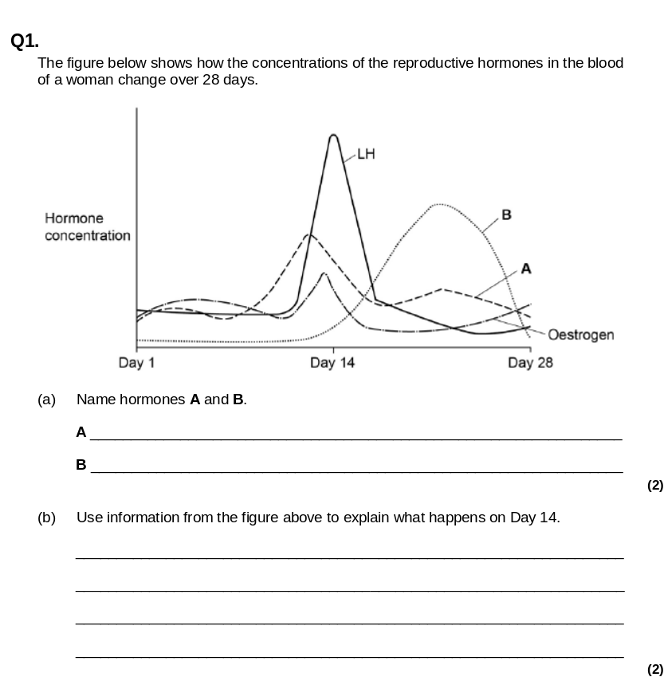
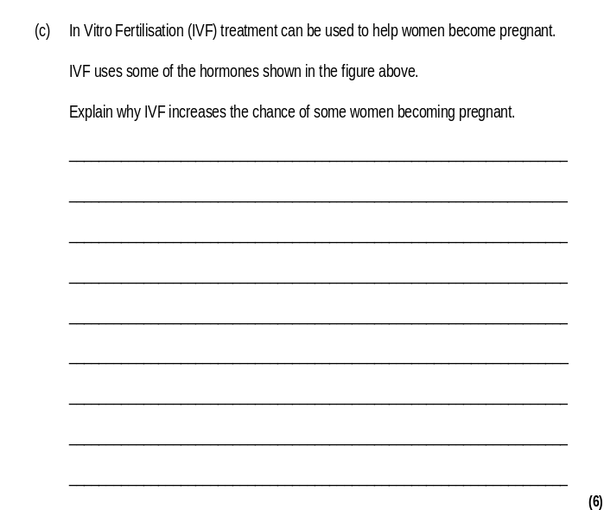
Menstrual cycle and IVF HIGHER ONLY
0 days - oestrogen and progesterone levels are low.
FSH begins to rise slightly, triggering a new egg cell to begin developing. FSH stimulates oestrogen levels begin to rise and the lining of the uterus begins to re-grow.
Before ovulation the levels of oestrogen, LH and FSH all reach their maximum but after ovulation they drop.
Progesterone and oestrogen rise to maintain the lining of the uterus.
If the egg is fertilised it will embed in the lining and progesterone and oestrogen will remain high.
If the egg is not fertilised then progesterone drops and menstruation happens. The cycle repeats.
IVF: In-Vitro Fertilisation is a sophisticated process that can help a couple conceive.
The woman is given a large dose of FSH and LH so she matures and releases many eggs
The eggs are collected
Sperm is collected from the father or donor.
Eggs are fertilised with the sperm. This is done ‘in vitro’ which means ‘outside of the body’.
The embryos develop in the lab.
When the embryos are a ball of cells they are implanted into the mother to be carried to term like a normal pregnancy.

Slide 7
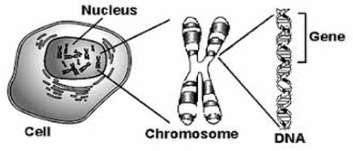
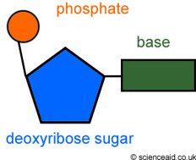
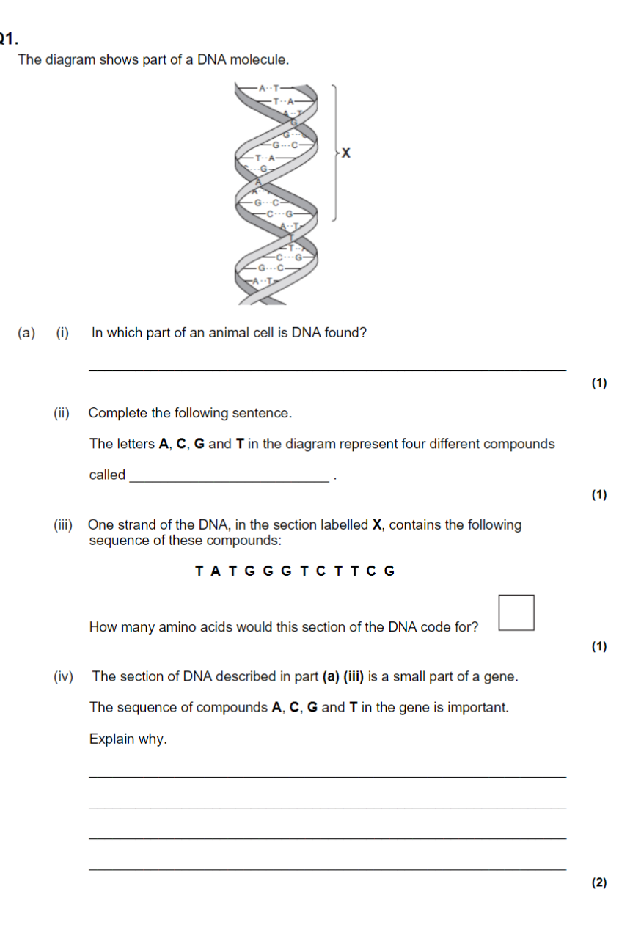
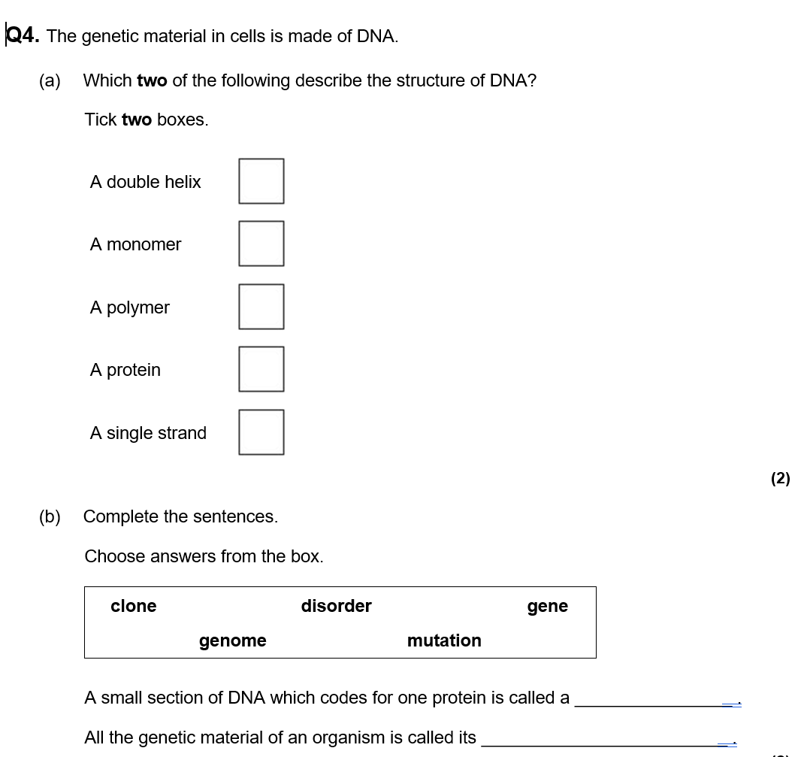
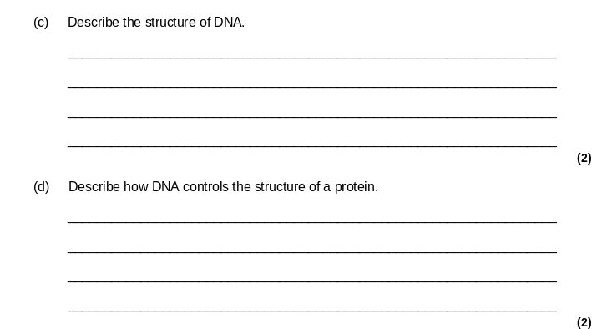
Genetics, Inheritance and Evolution Revision Part I
Do Now: Define these terms
-gene
-gamete
-nucleotide
- dominant
-meiosis
-recessive
-genome
-fertilisation
Genes and DNA
DNA is coiled into structures called chromosomes.​
The chromosomes are found in the nucleus of each cell ​
Human body cells contain 23 pairs (46)
An organisms complete set of genetic information is called its genome.
Genes are short sections of DNA which code for proteins
This is a DNA nucleotide (monomer). They join together to form DNA (polymer)
DNA is a very long polymer. There are sections of DNA called genes which code for specific proteins. These proteins are constructed by a series of amino acids. Each amino acid is coded for by 3 DNA bases. ​
The Human Genome Project (HGP) was an international scientific research project with the goal of determining the sequence of chemical base pairs which make up all of human DNA: over 3 billion base pairs long!

Slide 8
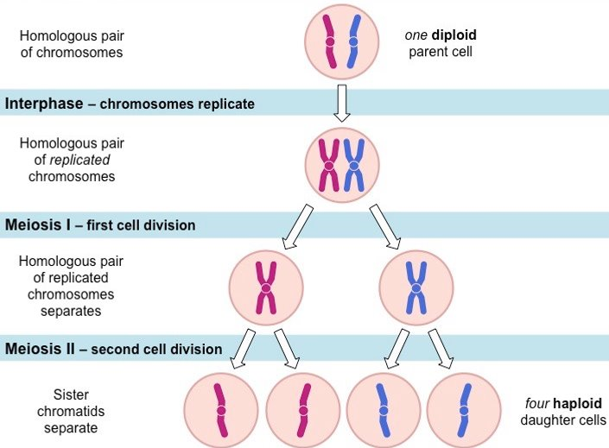
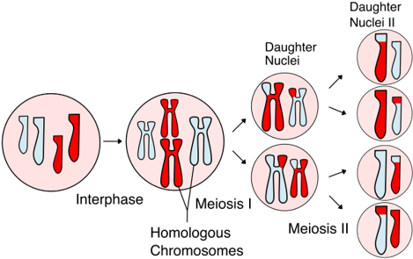
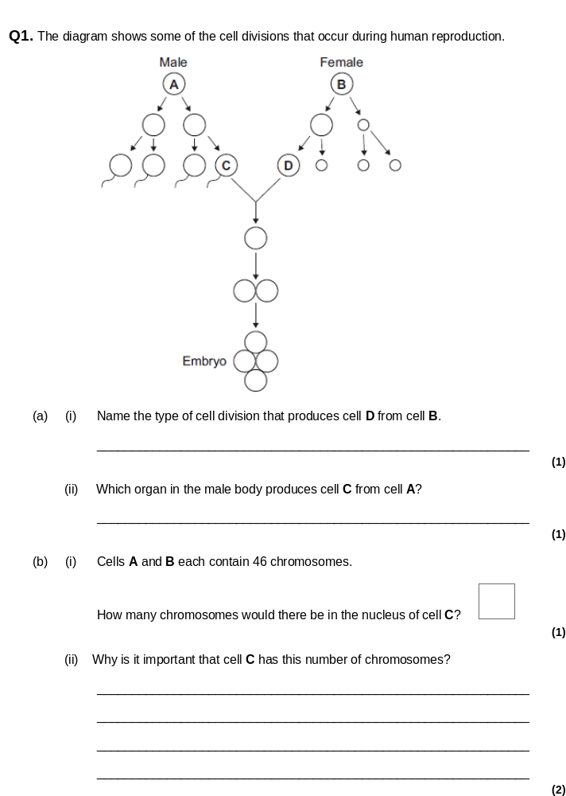
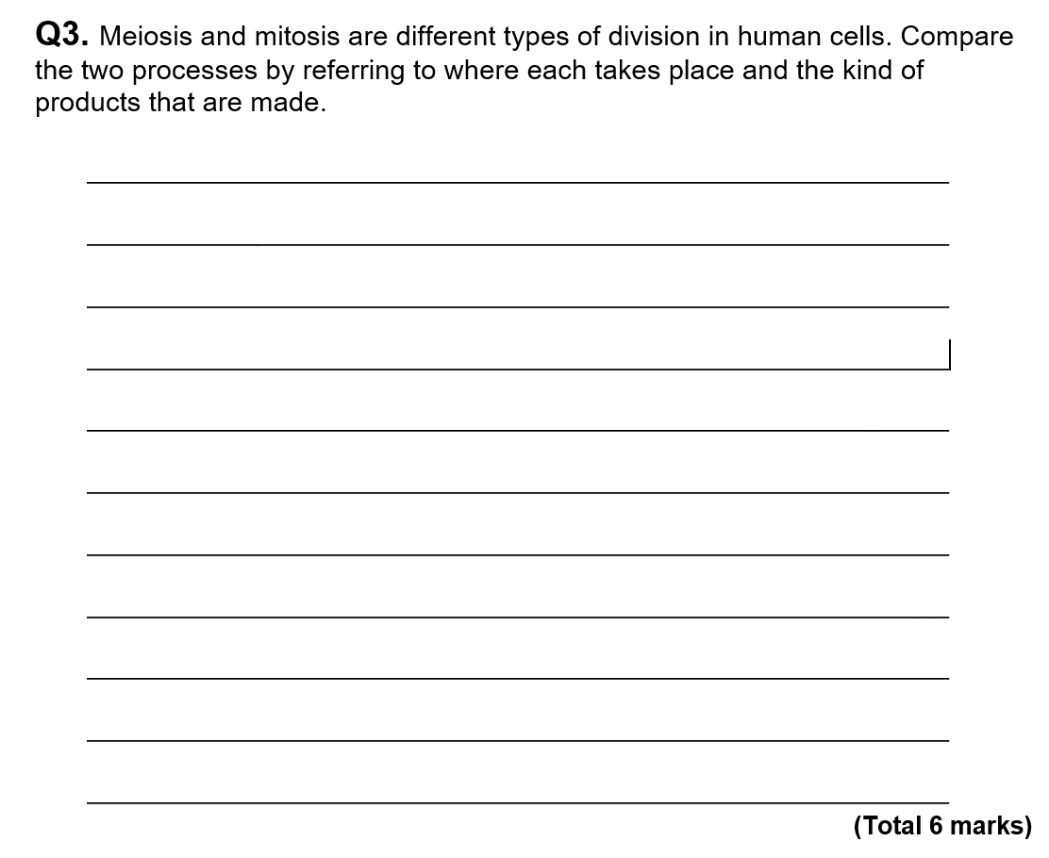
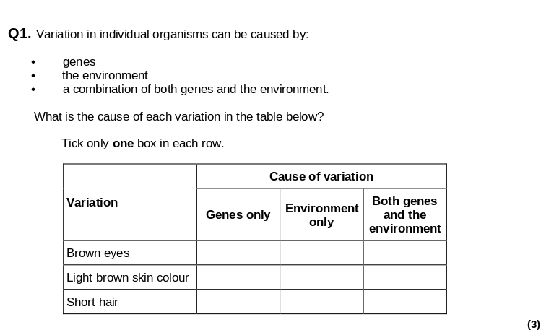
Meiosis and Variation
Before the first cell division of meiosis, homologous chromosomes exchange DNA by swapping sections. ​
​
This is called crossing-over.​
​
This creates genetic variation as new combinations of genes are made.
​ | Mitosis​ | Meiosis​
How many cell divisions are there?​ | The cell divide once​ | The celldivides twice​
How many cellsproduced​ | 2​ | 4​
How many chromosomes does it have?​ | 46 chromosomes– the same number asthe original cell​ | 23 chromosome – half the number ofchromosomes as theoriginal cell ​
When is used for?​ | To make newbody cells​ | To make gametes (sperm and eggs)
Where in the body does it happen?​ | It happens in all parts of the body ​ | It happens only in the testes and ovaries ​

Slide 9
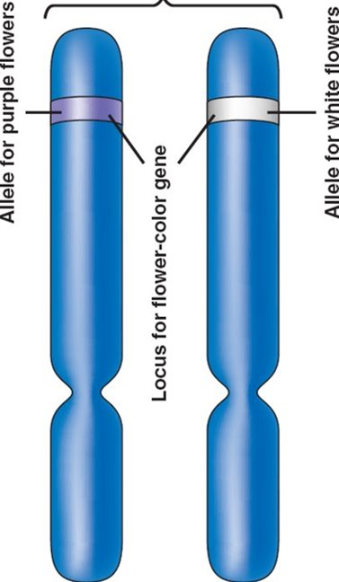
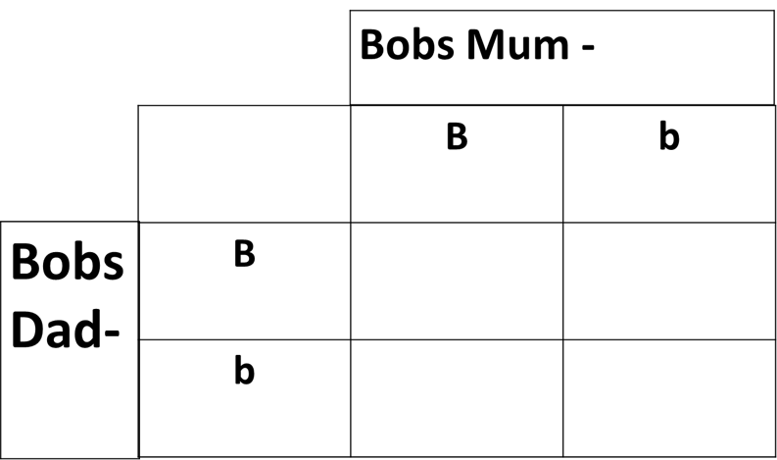
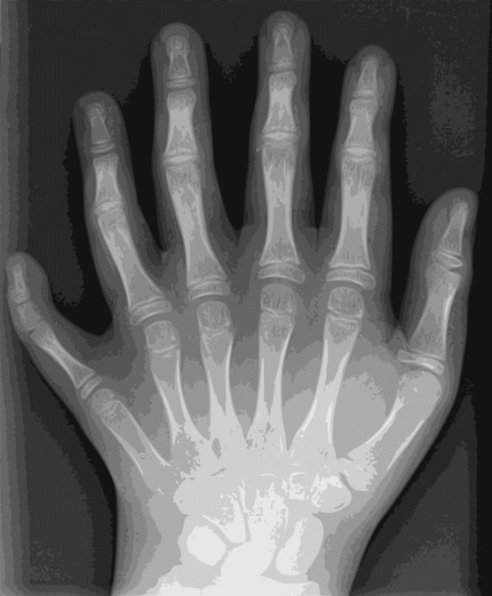
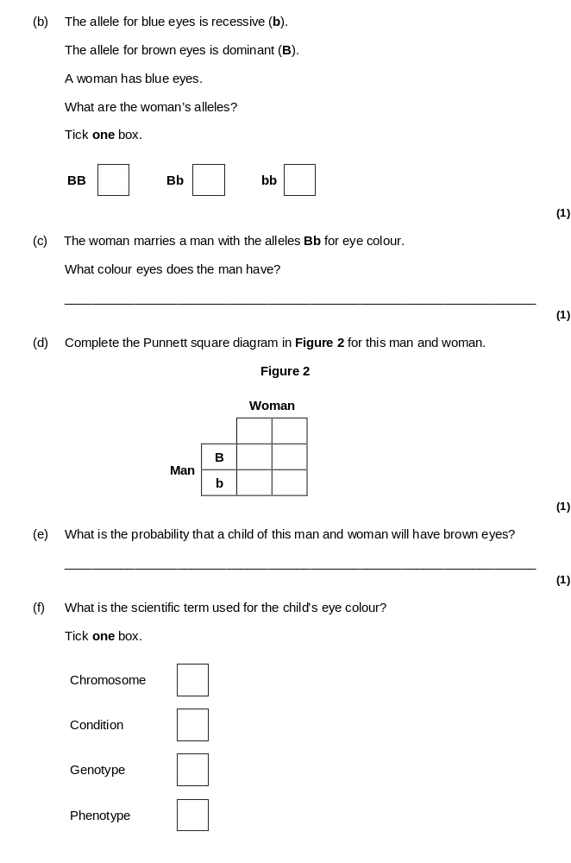
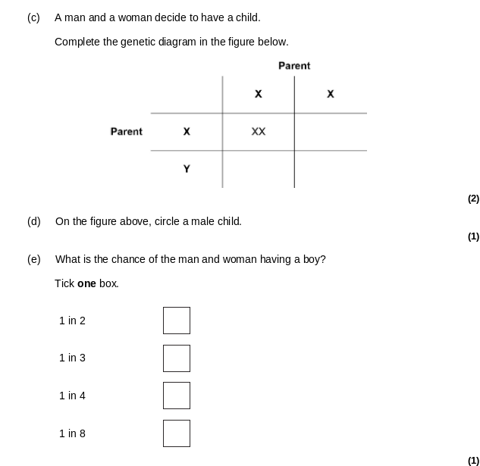
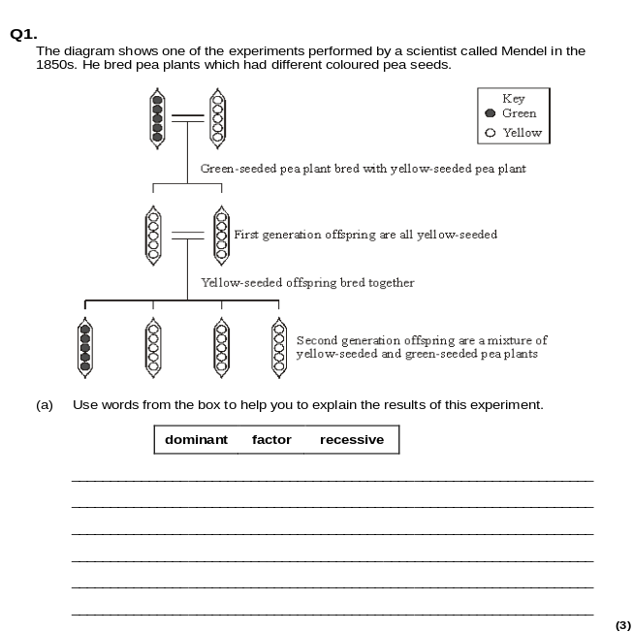
Inheritance and Genetic Disorders
An allele is a different version of a gene. We inherit two copies of every gene, one on each chromosome we get from each parent. They can be slightly different and are known as alleles.
If the two alleles of a gene are the same, the individual is described as being homozygous.
Example: BB or bb
If two alleles of a gene are different, the individual is described as being heterozygous. Example: Bb​
Dominant characteristics are always inherited over recessive alleles (represented by a capital letter e.g B).
Recessive characteristics are only inherited if both alleles are recessive (represented by a lower-case letter e.g b).
A punnett square can be used to perform a genetic cross to work out the probability of a certain allele being passed on. Remember - Probability means 'how likely' or 'what chance' - normally a fraction or a % e.g: 0.25 or 25%
Inherited diseases
They can be recessive or dominant. Cystic Fibrosis is caused by a recessive allele. Polydactyly is caused by a dominant allele.
Cystic fibrosis causes a build up of mucus in the lungs – sufferers are prone to chest infections. They need medication and physiotherapy as treatment. Polydactyly can be treated with surgery but it is not life threatening.
BB
25%
Bb
50%
Bb
50%
Bb
25%

Slide 10
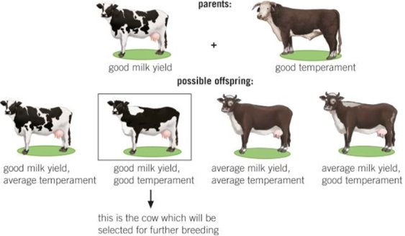
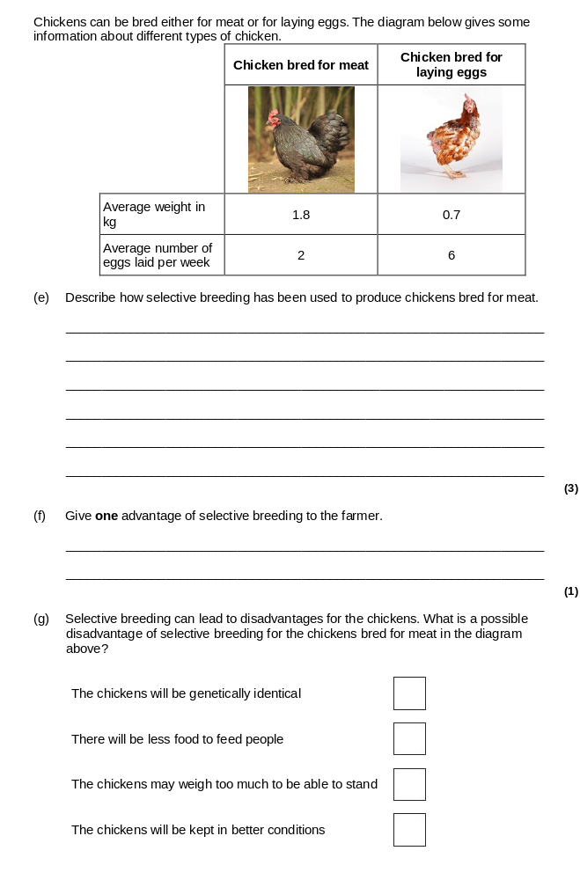
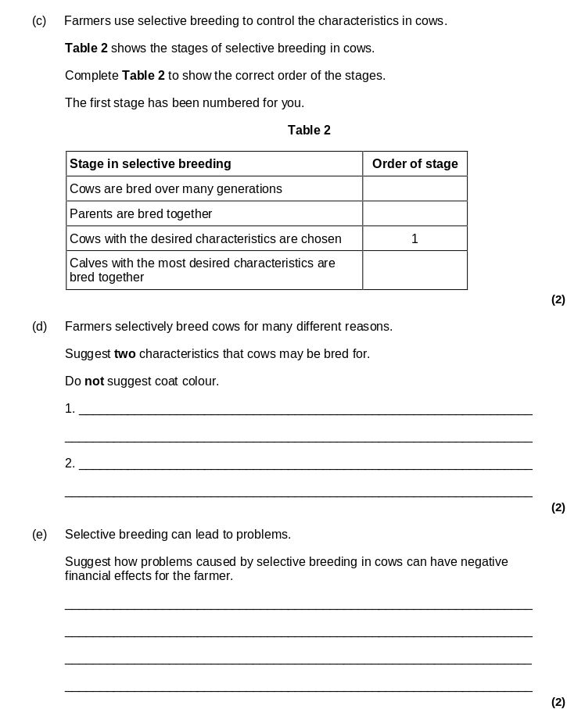
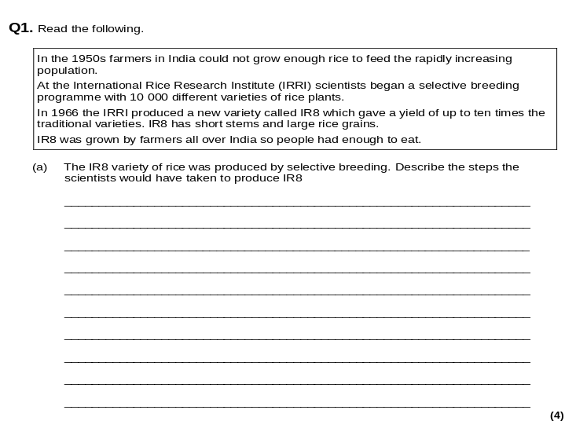
Selective Breeding
Selective breeding or artificial selection is the process by which humans breed plants and animals for desired characteristics.
The Process of selective breeding:​
Choose two individuals with the desired characteristic​
Allow them to breed, which produces offspring with a range of characteristics.​
Choose the offspring with the desired characteristic and allow them to breed​
Repeat this cross-breeding process over many generations until all the offspring show the desired characteristic.
Advantages​
Disease resistance in food crops​
Animals which produce more meat or milk​
Domestic dogs with a gentle nature​
Large or unusual flowers​
Disadvantages​
Reduces genetic variation so they are less likely to be able to cope with major environmental changes​
Inbreeding so they are more prone to certain diseases/inherited disorders​

Slide 11
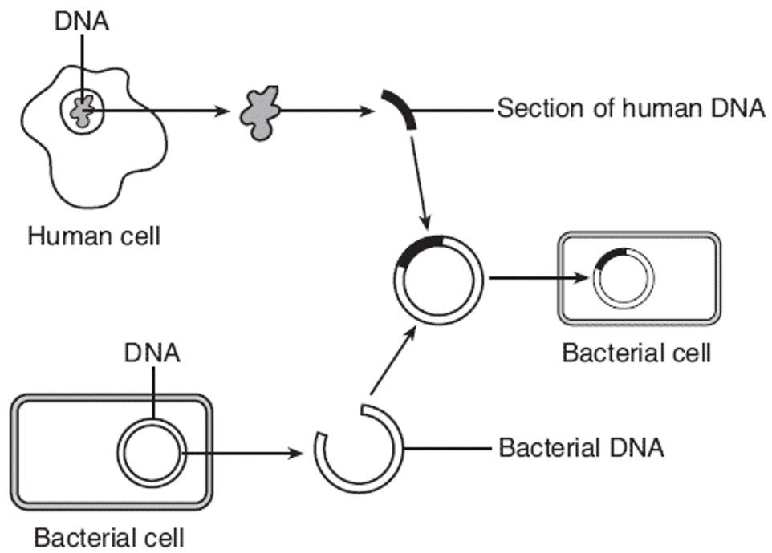
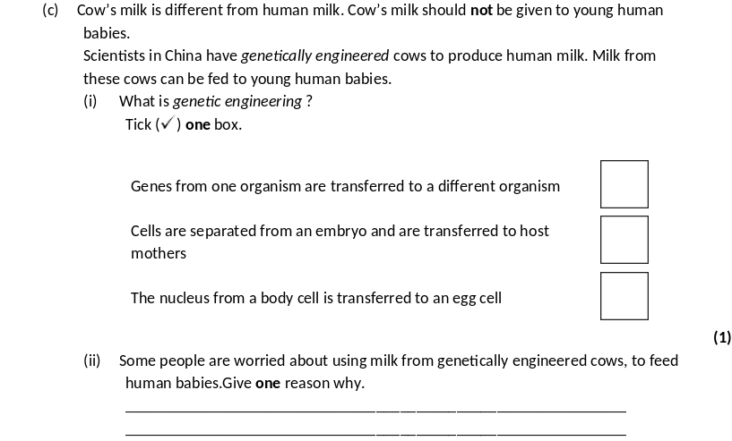
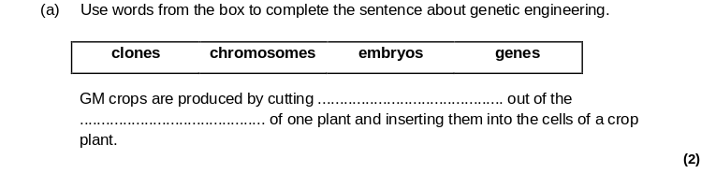


Genetic Engineering
Genetic engineering is a process which changes the genome of an organism by inserting a gene from another organism to give a desired characteristic
Methods (Higher Only)
Useful gene identified
Useful gene cut out using enzymes
Gene spliced with other organisms DNA
Plasmid with gene inserted into bacteria – if making insulin
Organism which has been genetically modified​ | Benefit​
Bacteria​ | To produce human insulin to treat diabetes​
Food Crops​ | Improve yield, and to make them resistant to pest or disease.​
Sheep​ | Sheep have been genetically engineered so that they can produce useful things in their milk, e.g. drugs to treat human diseases​
Humans​ | Scientists are working on gene therapy treatments to “cure” genetic inherited diseases​
Advantages of genetic engineering
Genetic modification is a faster way of getting the same results as selective breeding.
Improve crop yields or crop quality. This may help reduce hunger around the world.
Introduce herbicide resistance, which results in less herbicides being used.
Insect and pest resistance can be inserted into the plants.
Sterile insects could be created such as a mosquito. This may help with spread of diseases, such as malaria.
Risks of genetic engineering
Transfer of the selected gene into other species.
Some people believe it is not ethical to interfere with nature in this way.
GM crop seeds are often more expensive and so people in developing countries cannot afford them.
GM crops could be harmful or cause allergic reactions in people.
Pollen produced by the plants could be toxic and harm insects that transfer it between plants.

Slide 12





Genetics, Inheritance and Evolution Revision Part II
Do Now: Define these terms
-Natural Selection
-Population
-Species
- Evolution
-Adaptation
-Fossil
-Offspring
-Resistance
Natural Selection and Evolution
The theory of evolution says that all species of living things have evolved from simple life forms over millions or billions of years.
Evolution happens through a process called natural selection which changes the inherited characteristics over time.
Charles Darwin was the first person to explain evolution by natural selection:
There is variation in a species often caused by mutation.
The individuals which are best adapted survive and reproduce
Genes for the adaptation are passed on to their offspring.
Darwin’s theory of natural selection was initially rejected because:​
Most people still believed that humans have been on earth since the beginning​
Not enough fossil evidence at the time​
Mechanism of inheritance (genes) not known at the time.​
Evidence now:
Fossil record, we know about genes and how they are inherited
and we have resistant bacteria as an example of natural selection

Slide 13







Extinction and Fossils
Fossils are remains or impressions of dead animals and plants from millions of years ago, which are found in sedimentary rocks.​ Fossils are the most significant evidence to support the idea of evolution. Palaeontologists study the fossils, date them and put them in order. They reveal the gradual change of one type of plant or animal into another over time.
Problems with fossils as evidence:
They are rare as conditions had to be exactly right to make them
The record is incomplete (some are missing)
Mostly only hard parts of organisms can be seen as soft parts decay.
They can be easily damaged or destroyed by erosion.
Fossils can be formed by:​
Dead organisms are buried in sediment or imprints made in mud​
Soft body parts decay but hard parts do not​
Hard parts are replaced by minerals (mineralisation)
Sometimes fossils can be insects that have been trapped in amber (tree sap) so they did not decay because there is no oxygen.
Fossils can give us detail about extinct animals. Animals become extinct when there are no living individuals of a species left. The main causes of extinction
Changes to the environment (e.g. Human activity is causing global warming or habitat loss)
New predators
New diseases
More successful competitors
A single catastrophic event such as a volcanic eruption
Through the cyclical nature of speciation (natural selection)
​

Slide 14





Evolutionary Trees and Binomial Naming
Carl Linneas:
Developed the first classification system to group organisms based on their structure and characteristics.
Developed a binomial (two name) system for naming all species which we still use today
Binomial System
Definition of a species: a group of organisms that can breed together to produce fertile offspring.
Evolutionary trees show evolutionary links between different groups of organisms.
The closer the organisms are on the tree, the more closely related they are.
Organisms which share branches are related
Organisms which branched off first evolved first.
Most closely related to humans
Common ancestor of human chimpanzee and gorilla
Evolved first as first to branch off alone

Slide 15








Evolutionary Trees and Classification
Carl Linneas:
Developed the first classification system to group organisms based on their structure and characteristics.
Classification is the grouping of organisms into a hierarchical system.
It is useful because:
Helps us to know which species are closely related
Helps us to monitor biodiversity
Helps us to identify different organisms as separate species
King
Prawn
Curry
Or
Fat
Greasy
Sausages
Due to developments in microscopes, and biochemistry, we moved from the Linaeus system of two kingdoms (animals and plants) to using five kingdoms:
Research in the 1970s by Carl Woese developed a higher level of classification than the kingdom called a domain. We also moved to a six kingdom system.
Biochemistry and technology helped separate the prokaryotes (bacteria) into two groups: bacteria and archaea.

Slide 16






Ecology revision
Do Now: Define these terms
-habitat
-species
-community
-population
-neurone
-hormone
-synapse
-gland
Communities and Competition
Communities of organisms often overlap geographically and often compete for resources. This creates interdependence between species where one species survival depends on another species.
Within communities animals compete for food, shelter and mates (in the same species). Plants compete for light, water, nutrients, pollinators and seed dispersal.
Organisms compete with each other to try and survive so that they can reproduce and pass on their genes.

Slide 17







Biotic and Abiotic Factors and Adaptations
Abiotic factors are non-living factors like light intensity, temperature, moisture levels, soil pH, wind intensity and availability of oxygen and carbon dioxide. Each habitat will have a unique mix of abiotic factors causing different species to flourish. Biotic factors are the living components of an ecosystem. This include availability of food, new pathogens or parasites, new predators and competition between species.
For any organism to survive its needs to be well adapted to suit the environment in which they live. Adaptation definition: The features or characteristics that allow an organism to live in a certain habitat or environment. There are three types:
Structural (anatomy) e.g spines of a cactus
Behavioural e.g mating behaviour
Functional (physiology) e.g opening/closing of guard cells

Slide 18






Food Chains

Slide 19







Nutrient Cycling
Nutrients go back to the soil in waste products or when organisms die and tissues decay. Organisms decay because they are broken down by microorganisms usually in warm, moist, aerobic (oxygen) conditions.
The organisms that decompose (breakdown) dead organisms are called decomposers. They are mostly microscopic bacteria and fungi. Decomposers are a group of organisms which have adapted to feed on waste, dead animals and plants

Slide 20






Land Use and Pollution
Biodiversity is the measure of the variety of all species on earth, or in a particular ecosystem.
Biodiversity is reduced (number of different species decreased) by human activity when:
Habitat is lost or changed e.g deforestation
Ecosystems are disrupted by flooding or drought (caused by climate or humans )
Climate change causes extreme weather or changes in migration patterns
Pollution can be through air (burning fossil fuels increases CO² sulphur dioxide in the atmosphere) and , land or water. Sewage, radioactive waste, fertilisers, pesticides (chemicals that kill insects) and herbicides (chemicals that kill plants) can poison soils and make habitats not safe to live in (destroys them).
Land Use Examples: Peat Extraction and Deforestation
contribute to reduction in biodiversity because they remove habitats
Increase CO2 in the atmosphere because they are both carbon sinks (trees remove CO2 from the atmosphere through photosynthesis) and can release CO2 when they are burned or decayed.
They can both lead to soil erosion through increased flooding.

Slide 21





Biodiversity Global Warming
More carbon dioxide pollution from burning fossil fuels and more deforestation has caused a build-up of carbon dioxide in the atmosphere, more farming of cattle and growing of crops like rice has released more methane into the atmosphere. Carbon dioxide and methane are known as greenhouse gases along with water vapour, because they trap heat energy from the sun.
Climate change causes a reduction in biodiversity because it is linked to changes that animals cannot adapt to such as:
Habitat. As flooding by rising sea levels will destroy valuable coastal ecosystems
Weather. Wind patterns, rainfall and seasonal changes will lead to some species finding it hard to survive in their existing ecosystem. This may change where they can live or their distribution.
This is more likely for species that live in areas which will suffer the greatest change. For example, polar bears are at high risk of extinction because they live on ice in the coldest regions.
It is important to maintain biodiversity because: ​
We have a moral responsibility​ not to destroy the planet
Animals and plants can be useful for the development of medicines​
Aesthetic reasons​ (nature is beautiful)
We need to conserve ecosystems so that the planet functions (i.e. we rely on microorganisms for the breakdown of waste/ recycling of nutrients).​

